Slide 1
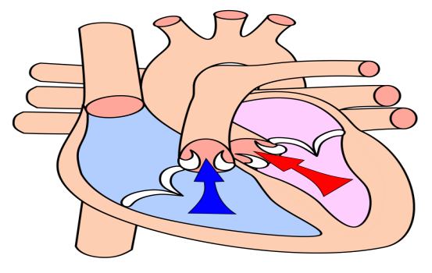
Event for families who are Electively Home Educating Looking After Your Heart By Chelsea Johnson, Medical Radiographer (Barts Heart Centre) To educate children about the importance of why and how to look after the heart to prevent/reduce heart diseases Suitable for children in KS2+ Wednesday, 25th September 2019 1.15PM – 3PM Idea Store Whitechapel
Organised by Tower Hamlets Education Safeguarding Service in partnership with Idea Stores and Barts Heart Centre

