Slide 1



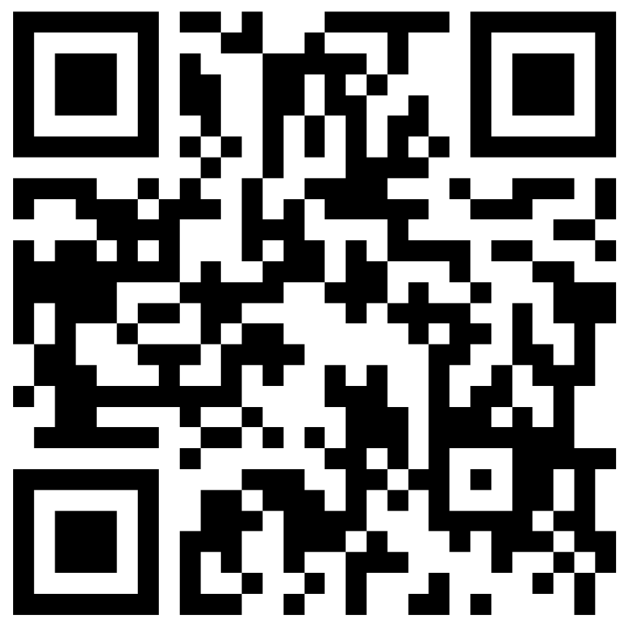







Children and Adolescent Mental Health Services (CAMHS)
Exciting Opportunity!
Join our CAMHS Young People Group
At CAMHS, we value the voices & experiences of the young people who use our services. That’s why we’ve created this exciting group!
Register and join us for our first meeting by scanning the QR code
When?
Wednesday 25th February
What time?
18:00 – 19:30
Where?
Online (Microsoft Teams)
What time?
  Anyone aged 13 to 25 & accessed
  CAMHS team in Berkshire
(Including if you are currently accessing CAMHS, waiting to, or have accessed CAMHS in the past)
The group is a space where you can help shape and improve Berkshire CAMH services, by:
Sharing your views, ideas and opinions
Giving feedback
Working alongside our team
For any questions please contact:
CAMHSvoice@berkshire.nhs.uk

Slide 2

More information (web page to be created):
CAMHS Young People Group
Register and join us for our first meeting; form & QR link:
https://forms.office.com/e/aG61EbxLbA
This is a space for you to use your experience to guide our work and make sure the support we offer truly meets young people’s needs. We want to listen to you, and involve you in the important decisions that affect your care and the care of others.
The group is also a place to:
Meet other young people
Build confidence
Gain skills and experience (this can support you in education, training, or future work).
At the first Young People’s Group Meeting on the 25t February, we hope to talk about things like:
1. Welcome & Introduction
2. Why We’re Here
3. Your Voice: What Do You Want This Group To Be? Open discussion:
4. Activities: Choosing a Group name & Designing a poster/flyer to promote the Group.
5. Shaping the Group Together: discussion and vote about:
Location for future sessions
Best meeting day / time
For any questions please contact:
CAMHSvoice@berkshire.nhs.uk

