Slide 1



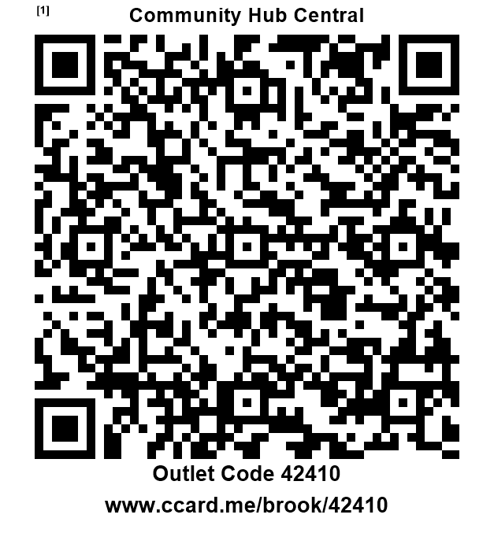
Community Hub Central Hartlepool
16–24 year-old
Free Condoms Here
Condoms
Advice on contraceptive methods
Signposting to emergency contraception
Free and Confidential
Venue: Community Hub Central 124 York Road Hartlepool TS26 9DE Health Improvement Team
Dates times
Wednesday
11th June & 25th June
4 p.m. – 6 p.m.
brook.org.uk
16 or over ?
Complete the confidential online registration and just give your code to collect your condoms - Scan the QR code now!

