Slide 1


Our Time All Ability YOUTH FORUM
Tower Hamlets

Slide 2
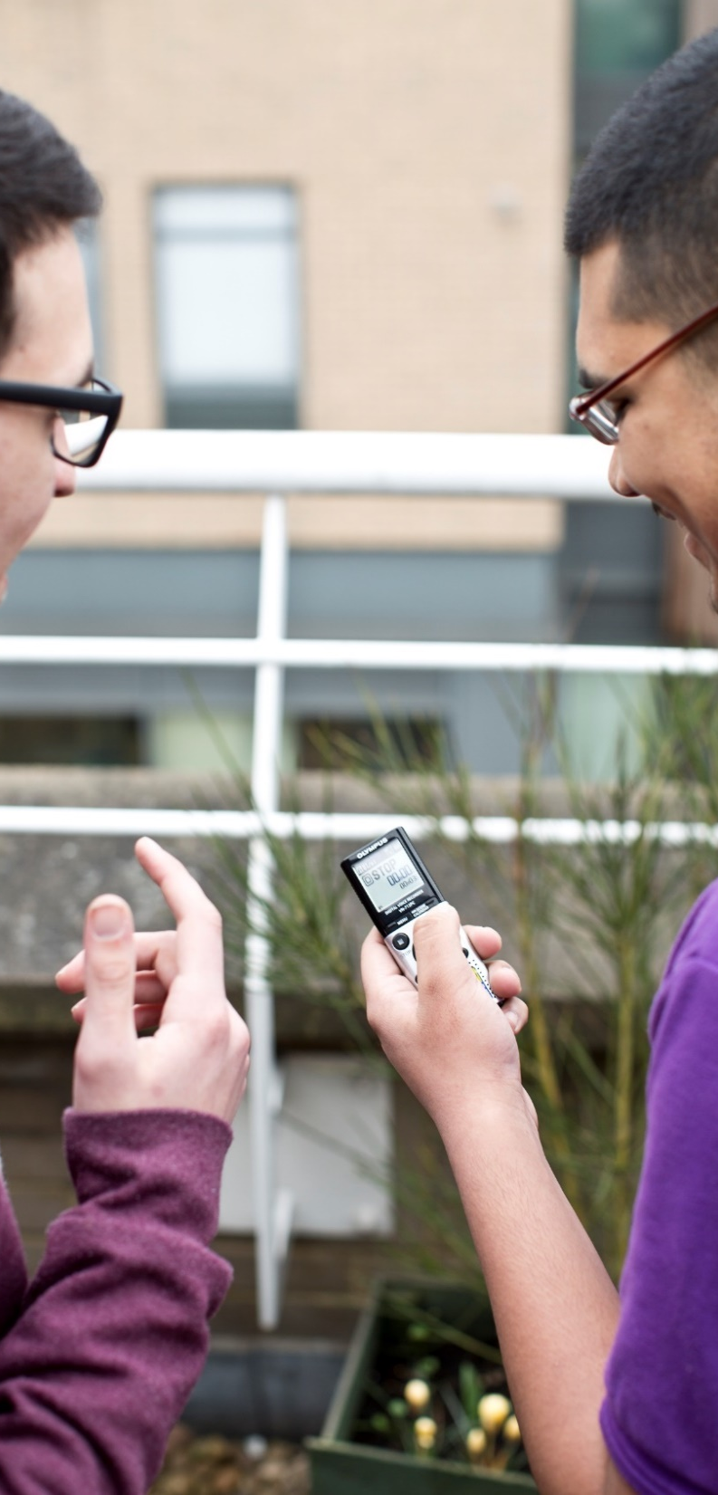

We are run for and by young people, 14 – 25, with special educational needs and disabilities

Slide 3
We have achieved the following:
Run a peer research project
Participated in National SEND Conferences
Completed ASDAN Leadership Course
Given presentations at staff events
Made art and poems with the A-Team Arts Service
Organised Events for young people and Community
Taken part in Local Consultations
Run our kitchen cooking club

Slide 4
Mental Health Champions
Run workshops and given talks in schools and colleges
Attended and are members of Stakeholder groups e.g. SEND Improvement Board
Workshop at National CDC (Council for Disabled Children) participation conference
Working with Spotlight SEND Superheroes to represent younger voices
Presentation to LA Children and Culture staff
Representation on the CDC National Steering Group
Made films based on Autism, EHCP, personal budgets and training education psychologists

Slide 5
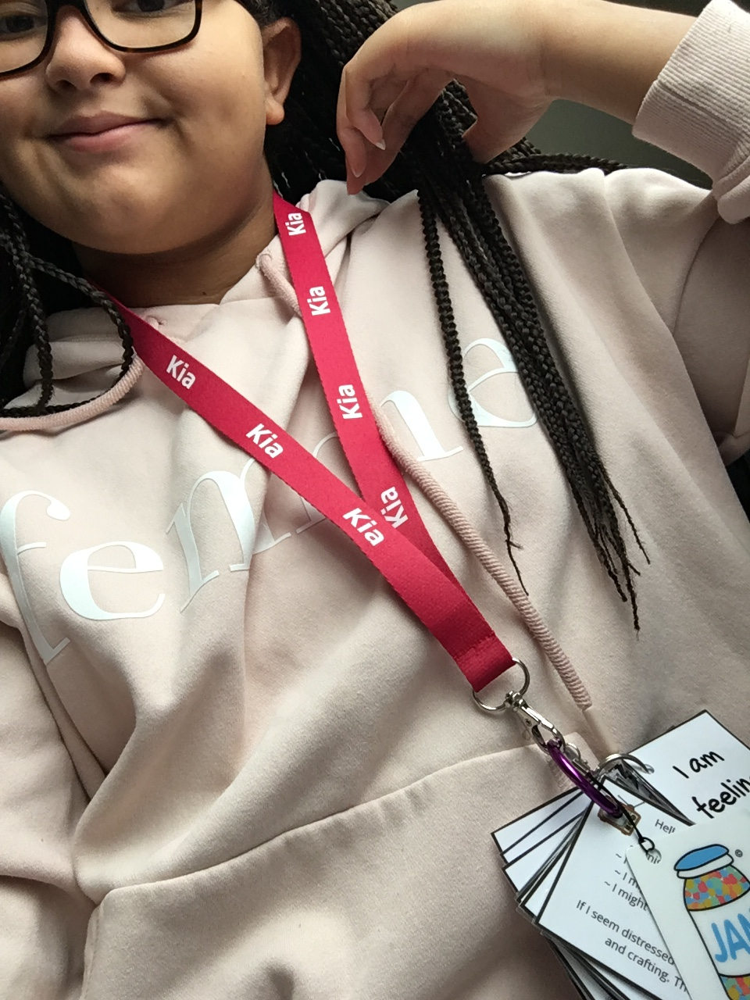
We empower and inspire
We support
others to grow

Slide 6
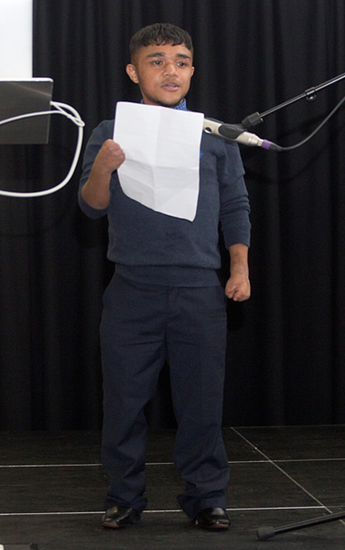
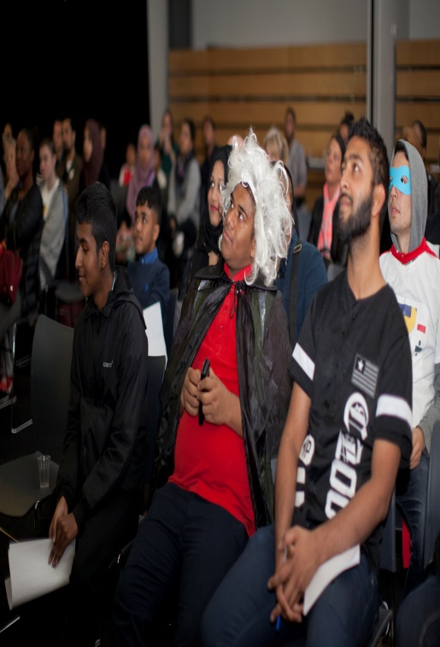
Abadur Rahman
If you come to the youth forum you will feel welcome, you won’t feel left out, and you’ll get your voice heard.
Aklakur Rahman
We all understand the same feelings that we’re all going through. We know we’re not the only young people with additional needs. There are lots of people like us all over the country. So you are not alone.

Slide 7
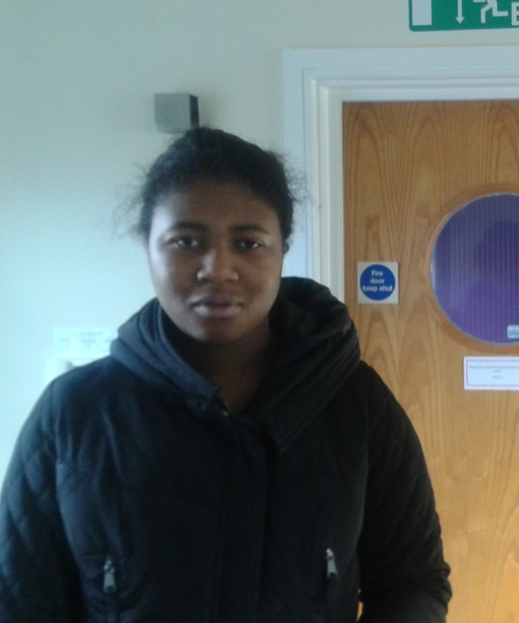
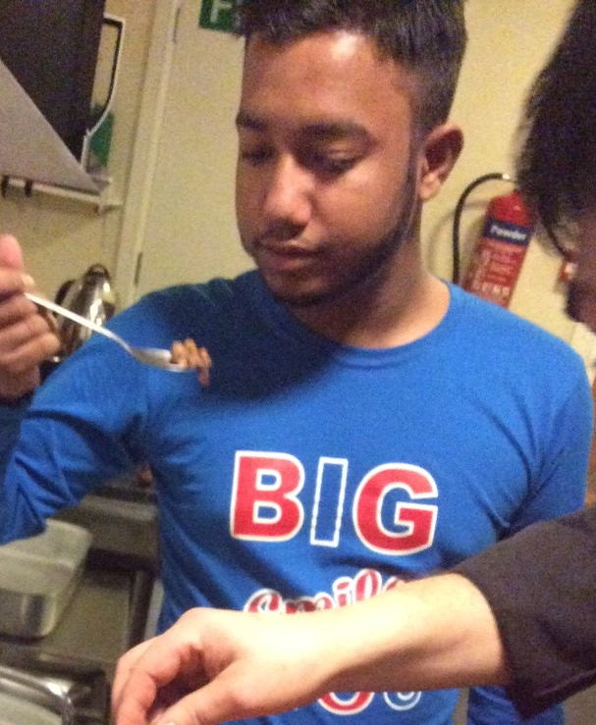
Lydia Anderson
We do lots of things at the forum. We make films, we plan what to do, we do all different projects and we have events. We tell people what we want and what will help us.
Ruhul Amin
The youth forum is a great opportunity. Use this opportunity while you can. Come and get involved in all the different activities that we do.

Slide 8
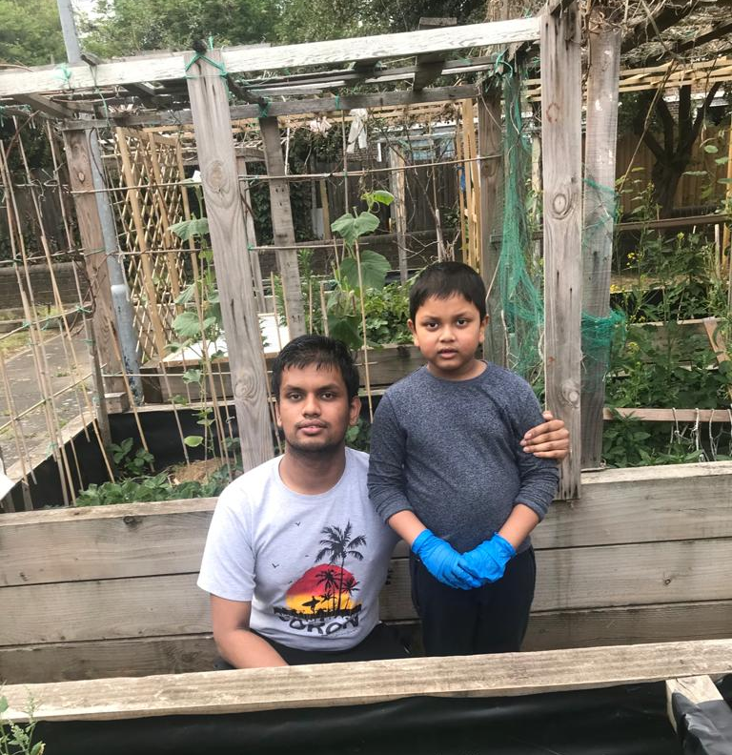
We:
- cook
- campaign
- fundraise
- make films

Slide 9
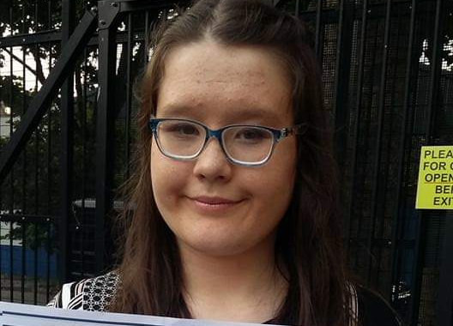
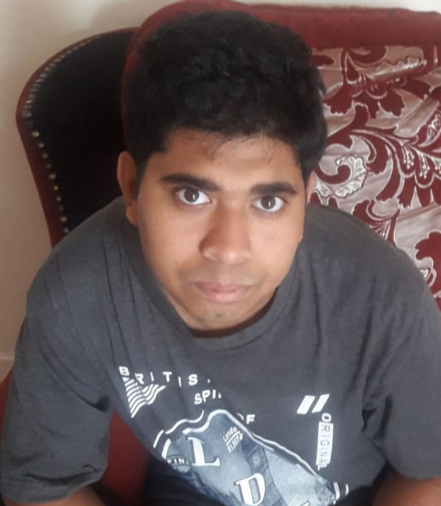
We:
- write poems
- make art
- Work with professionals
- represent young people
- consult

Slide 10
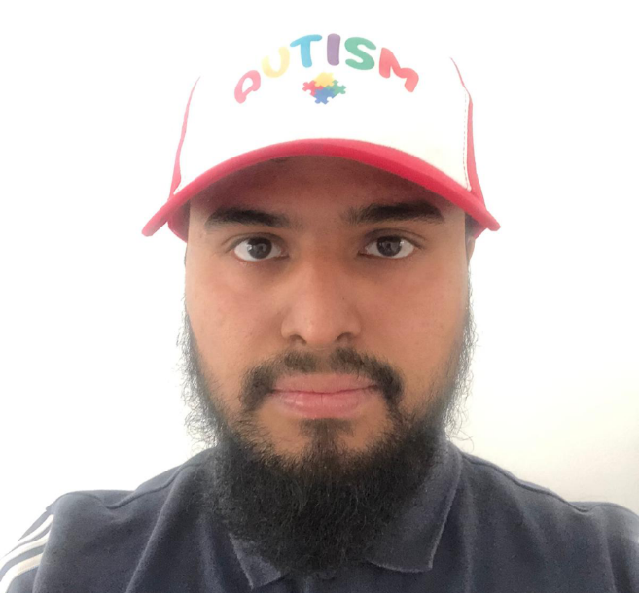
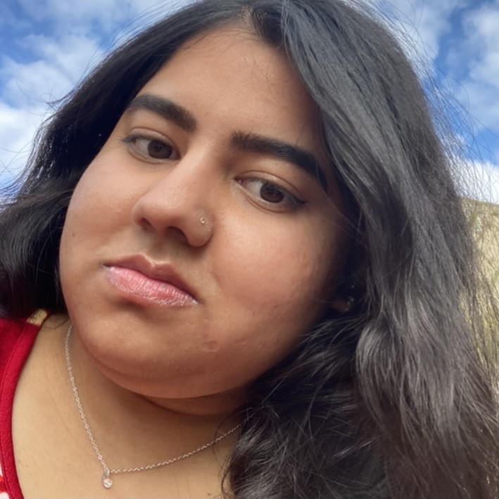
We give a voice to young people

Slide 11
NEXT STEPS FOR OUR TIME ARE:
We would like to develop a Pan London group to represent voice of YP with SEND at regional level
Secure funding to develop the scope and reach of the group
Visit the Houses of Parliament
Further develop the Young People Zone on the Local Offer
Mystery Shopping Services
Further promote Independence for SEND with parents and professionals
Continue to recruit new members and spread SEND awareness
Support to promote anti-bullying in order to increase inclusion rates
Work in the community to promote inclusion
Work with younger groups to help achieve their potential

Slide 12
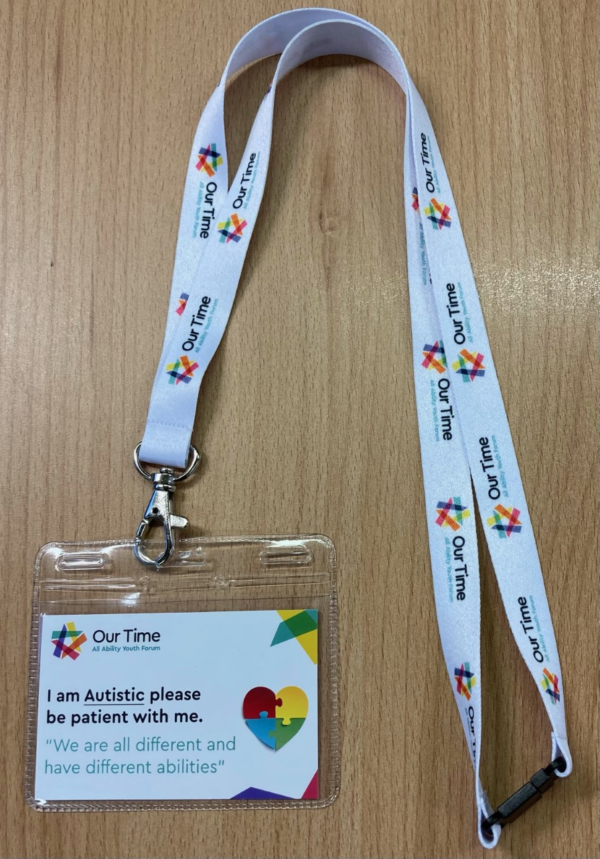

Front
Back
ASD Cards designed by Our Time members

Slide 13





Slide 14
What support does Our Time need?
Others to support promoting Our Time for recruiting more young people with SEND
Funding for Young People’s Forum work
More employment opportunities for young people with SEND
Finding possible funding options to employ young people with SEND as in working with developing Forums across London
Funding to support mentoring project run by YP with SEND for other YP with SEND

Slide 15
Please get in touch and come along to meetings
020 7364 6489
https://www.localoffertowerhamlets.co.uk/young_peoples_zone
Ourtime.yf@gmail.com
Facebook.com/ourtime.yf
Twitter.com/ourtime14
Instagram
Our Time
Every star is different

