Slide 1

Introduction to Young Workpath
Young WorkPath
Fiona McMullan
Lead SEN Careers Advisor

Slide 2

Who are Young Workpath?
The Careers Service for Tower Hamlets.
Support young people Year 9 onwards (up to age 25 with an EHCP).

Slide 3
Who are Young Workpath?
We provide impartial advice and guidance to young people and their parents/carers to plan next steps in education after Year 11.
We can provide practical support to find full time employment or an apprenticeship.

Slide 4
Where do we work?
We support young people attending all schools and colleges in Tower Hamlets, including special schools and colleges.
Careers Advisors work in mainstream and Lead SEN Careers Advisors work in special schools and colleges.
There are 2 Lead SEN Careers Advisors – Fiona and Gill
We support young people attending school or college out of the borough, or who are educated at home.
Notes:
You may be thinking Why is guidance important? Some of you may have a clear idea about what you want to do... guidance is important because It looks at where you are now what are plans are for the future and makes sure you are aware of all the options open to you
To make informed decisions you need to find out about future trends in the job market, what qualifications you can take
An important part of careers guidance is to provide you with LMI.
When you leave school some jobs may no longer exist – e.g 5 jobs that did not exist when you started school
Social media managers | influencers|big data scientist |cloud architects | professional gamer
As careers adviser we have to keep up to date with trends in the job market both nationally and local
resources - Careers information leaflets |websites|networks

Slide 5
What do we help with?
Planning for post 16 education or training.
Planning for post 18/19 education or training.
Referral to other agencies for specific support to plan for life after education

Slide 6
When will you meet us?
Young people and parents/carers –
Year 11 Annual Review meetings and Year 13/14 Annual Reviews.
Young people –
Year 11 Careers Interview and Year 13/14 Career Interviews (some schools invite parents).
We can meet students in other school years as needed.

Slide 7
What is a Careers Interview?
A 1:1 meeting with a student. Students can be supported by a member of school staff they know.
30-45 minutes. Can be longer or shorter depending on student.
Aim is to get a young person’s views and preferences for education or employment.
The Careers Advisor might spend time in a young person’s classroom instead.

Slide 8



Careers interviews
Careers Interviews can be adapted according to the needs of each young person. This might be:
Asking the young people what they need to feel comfortable
A TA or Teacher attending with them
Visual resources and worksheets
Practical Tasks

Slide 9
What is a Careers Interview?
Explores a young person’s interests and skills at school and outside of school.
Explores a young person’s education and training options after Year 11 or Years 12/13 14.
Explores a young person’s preferences for the future – this could be employment, education or other goals.
Students, school and parents/carers receive a Careers Action Plan after the interview.

Slide 10

Action Plans

Slide 11
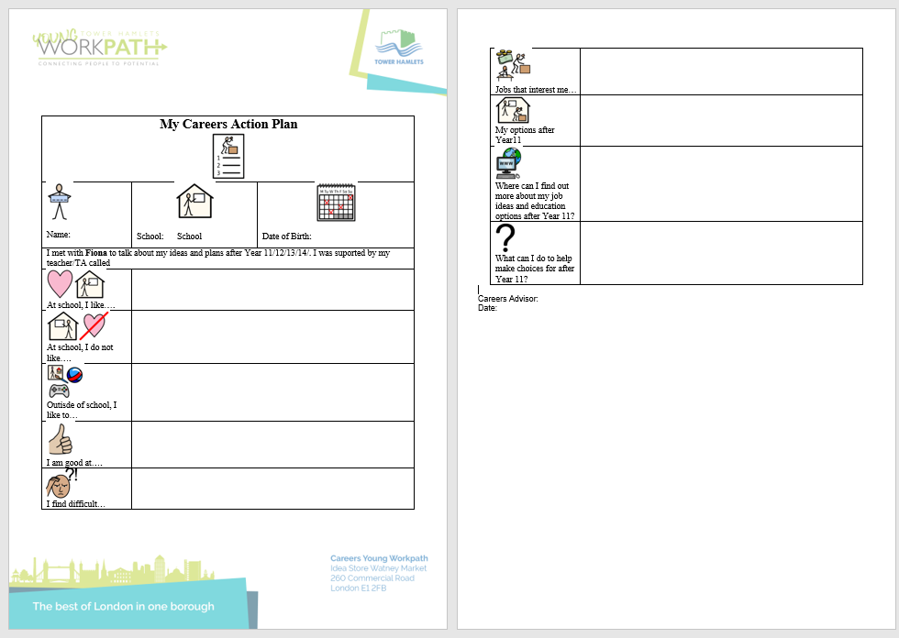
Action Plans

Slide 12
What are my child’s education or training options with an EHCP?
Mainstream school sixth form
Special school sixth form
Further Education College on a mainstream course
Further Education College on a SEN/Foundation Course
A specialist FE college

Slide 13
What are my child’s education or training options with an EHCP?
Apprenticeship (Up to Level 3)
Supported Internship (Year 13 onwards only)

Slide 14
What to think about when planning beyond Year 11?
Level of course
Subject
Support
Travel
Destinations beyond the course or training

Slide 15

ANY QUESTIONS

